Slide 1
Opening a Filipino Restaurant in Toronto
IBM final capstone project

Slide 2
Project outline
Background & business problem
Data Processing
Methodology
Results
Discussion
Conclusion

Slide 3
Background / Business Problem
The Filipino community comes in third place behind China and India among the largest minorities in Canada
Its estimated that this immigration trend will only move upward with the majority of the Filipino community residing in Toronto (62 %), consequently such increasing flow of settling requires an equivalent increase in services and amenities (ex. Restaurants).

Slide 4
Target Audience
This project will be mainly aimed at the following:
Existing Filipino Restaurants owners who are willing to expand their restaurants to new neighborhoods and enhance their reach.
Entrepreneurs of the Filipino community hoping to start a new venture in Toronto.
Foodies/ Tourists interested in finding neighborhoods with Filipino cuisines.
Filipino Newcomers/Residents who are considering to relocate to Toronto.

Slide 5
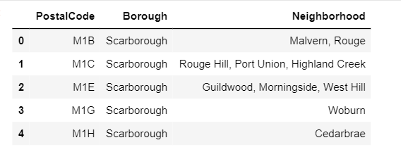
Data Processing / List of Toronto`s Neighborhoods
First we used the Wikipedia page (en.Wikipidea.org/wiki/List_of_postal_codes_of_canada:M) which was used to list all the neighborhoods, Postal codes and Boroughs of Toronto

Slide 6
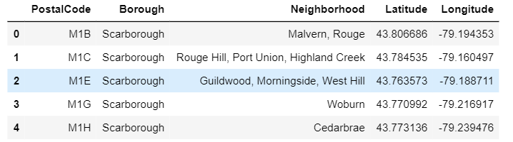
Data processing / The coordinates of the Neighborhoods
The csv file, “https://cocl.us/Geospatial_data” , was used to get all the geographical coordinates of the neighborhoods

Slide 7
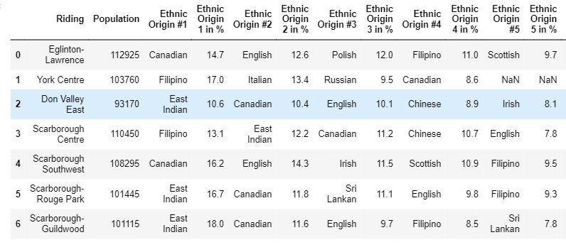
Data processing / The Filipino Demographic in Toronto
Wikipedia page (en.Wikipidea.org/wiki/Demographic_of_Toronto) shows the ethnicity percentages as per riding. we confined our ridings to include the ones with Filipino population in them.

Slide 8
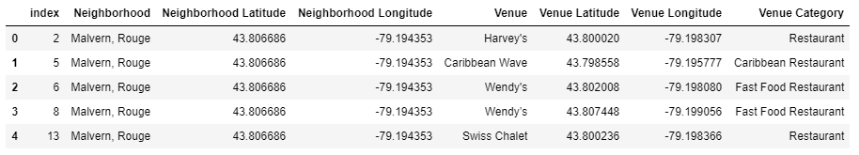
Data processing/ Locating venues in Toronto’s neighborhoods
Using Foursquare to explore Toronto's neighborhoods , The search radius was expanded to 1700m and the venues limit to 900. Inputting the longitude and latitude of Toronto, and filtering the venues to only include “Restaurant” Category

Slide 9
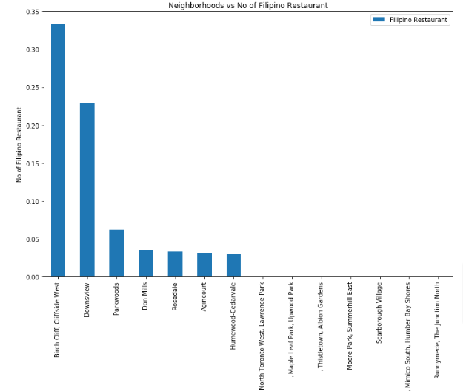
Methodology / Filipino restaurants distribution
Using Foursquare, we can determine the neighborhoods that are highly densed with Filipino restaurants in order to avoid the big & well established competition.

Slide 10
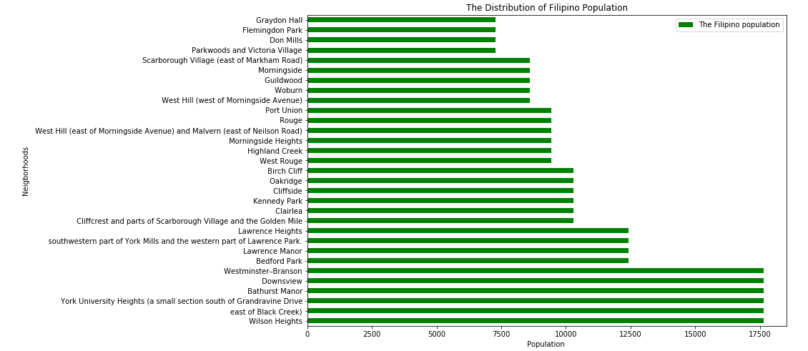
Filipino Population distribution
we extracted the ethnicity data of Toronto found in the table (table-3) and tried to sum all the percentages in each riding into total population in their respective neighborhoods. as the graph below shows

Slide 11
Neighborhoods clusters modeling
K-mean clustering is an unsupervised machine learning algorithm which groups objects in such a way that similar samples go into a cluster and dissimilar samples fall into different clusters. we used this algorithm, in this case, to cluster Toronto’s neighborhoods based on the Filipino restaurants in each.
After running the modelling , we ended up with a total of 6 clusters. Next ,we merged the cluster labels with the previous list that contains Toronto`s neighborhoods with the corrsponding numbers of Filipino restaurants and their locations so we can examine them in the next section

Slide 12
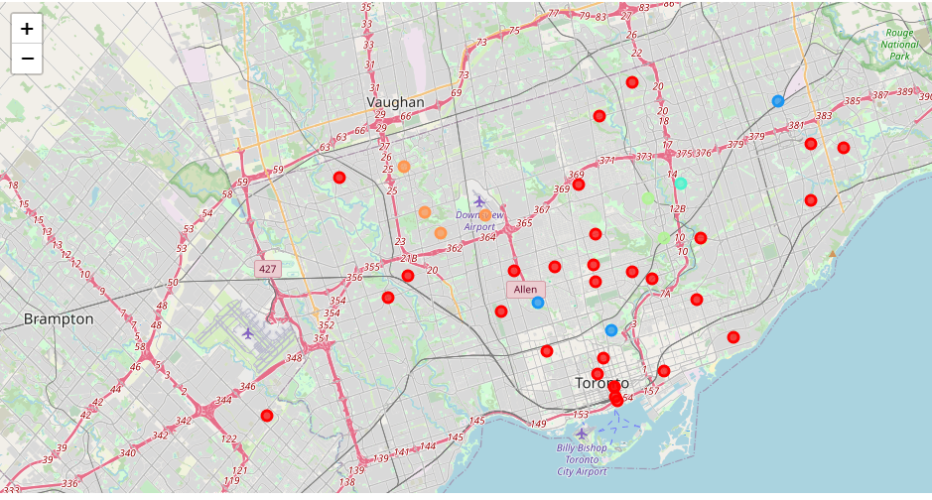
Results
Cluster 1 doesn’t contain any data points nor neighborhoods,
Cluster 0 , It has the neighborhoods with no amount of Filipino Restaurants, Its shown in red color on the map
Cluster 2 contains the neighborhoods with a wide range of distributed Filipino restaurants, Shown in blue.
Cluster 3 contains the neighborhoods that are highly occupied with Filipino restaurants, Shown in turquoise.
Cluster 4& 5 contains the neighborhoods that are relatively medially occupied Filipino restaurants, Shown in orange & green .

Slide 13
Results
the majority of the Filipino residents are situated in the ridings of York Centre, Scarbourgh Centre and Eglinton Lawrence.
In terms of neighborhoods, some of the neighborhoods with the highest population of the Filipino community in descending order are Wilson Heights, East of Black Creek, York University Heights, Bathurst Manor, Westminster-Branson, Bedford Park, Lawrence Manor, Birch Cliff, Rough, Morningside Heights, Guildwood, Flemingdon Park and Dons Mills.
Using the foursquare, It can be perceived that the highest number of Filipino Restaurants is located in the neighborhoods of Birch Cliff, Cliffside west, Parkwood, Downsview, Humewoods-Cedarvale, Don Mills, Rosedale and Agincourt.

Slide 14
Discussion
limiting our location selection primarily to be in a cluster with low density of Filipino Restaurants, namely Cluster 0 & 4 while discarding the rest to avoid the fierce competition. Then we will choose the option with the neighborhood that contains the highest number of Filipino community.
Four neighborhoods can be identified which are Scarborough village, Woburn, Victoria village & Don Mills. These neighborhoods should be a profitable option since they provide very low competition with high customer traffic.

Slide 15
Discussion ( recommendations)
Its advisable to use another location data platform such as Google or Kaggle for more accurate labelling .
The Filipino population taken from Wikipedia only represents the neighborhoods of the highest percentage and not all Filipino communities, moreover it’s based on the 2016 census data which is over 5 years old.
Renting prices, safety and Public transportation availability should be considered to refine the options more. investors might be interested to opt for a cheap, safe neighborhood with a good transit connection.

Slide 16
Conclusion
This paper presented some exploratory analysis of foursquare & Wikipedia data along with machine learning techniques (K-mean Clustering).
It was utilized to explore & examine the different neighborhoods of Toronto in order to determine the most optimum location to open a Filipino restaurant that will serve a bigger audience.
The neighborhoods of Scarborough village, Woburn, Victoria village & Don Mills were found as the best option for a Filipino restaurant.
It was recommended for investors to look into the renting prices in these neighborhoods, in addition to the safety & transportation efficiency.

